Slide 1
Unit 4
Data Scaling
20PITC57J- DATA ANALYSIS AND VISUALIZATION

Slide 2

Syllabus
Course Learning Rationale (CLR):
Exploring deep insights in Data scaling
Course Learning Outcomes (CLO):
Using the knowledge of perception and cognitive to evaluate Data scaling and its comparisons
Data Scaling: Need of Data scaling with example
Data Standardization Vs Normalization.
Standard Scaling approach: Characteristic of scaled data, Merit and Demerit of this technique
Lab 10: Performing scaling using raw formula and sklearn library
Minmax Scaling approach: Characteristic of scaled data, Merit and Demerit of this technique
Robust Scaling approach: Characteristic of scaled data, Merit and Demerit of this technique
Normalizer Scaling approach: Characteristic of scaled data, Merit and Demerit of this technique
Lab 11: Performing different scaling and compare its outputs
Comparison between scaling and transformations
Feature Engineering : Deriving new feature
Identifying the feature significance use univariate and bivariate/multivariate analysis
Lab 12: Deriving new possible feature and understand the feature relationship

Slide 3


Can we compare Mango and Apple?
Both have different features in terms of tastes, sweetness, health benefits etc.
So comparison can be performed between similar entities else it will be biased
Data Scaling

Slide 4
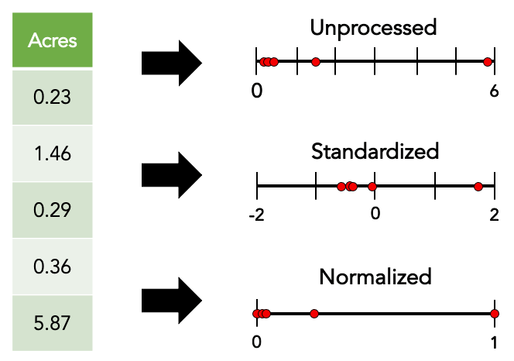
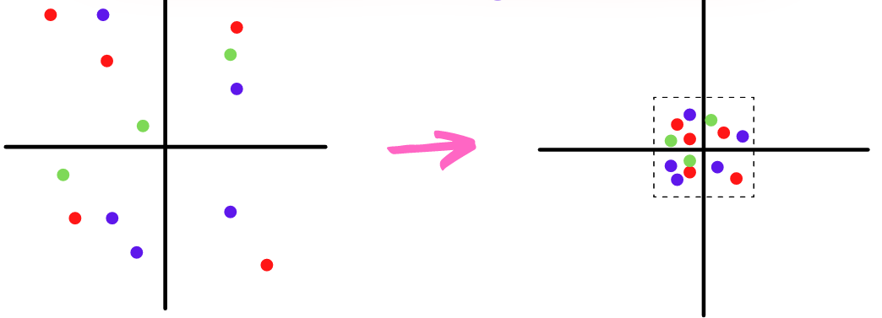
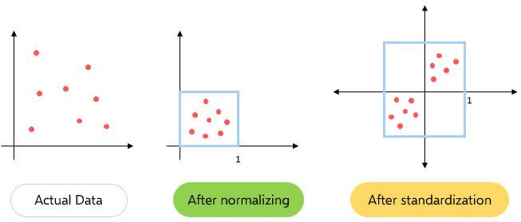
1. Data Scaling
Feature Scaling?
Feature Scaling is a technique to standardize the independent features present in the data in a fixed range.
Feature Scaling

Slide 5
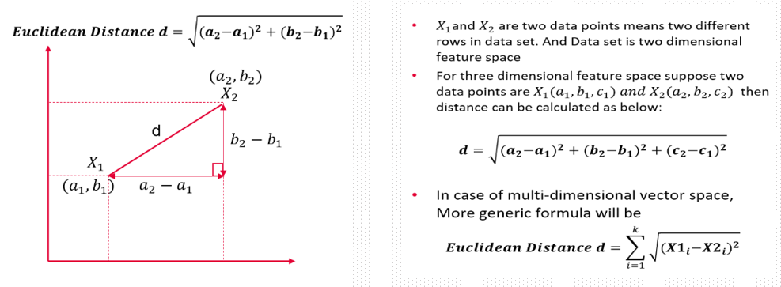
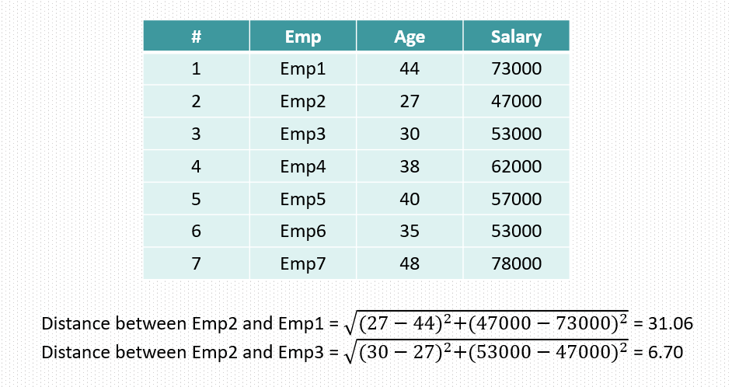
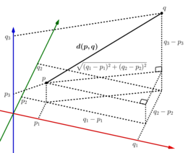
Euclidean distance between two points in Euclidean space is the length of a line segment between the two points. It can be calculated from the Cartesian coordinates of the points using the Pythagorean theorem, therefore occasionally being called the Pythagorean distance.

Slide 6
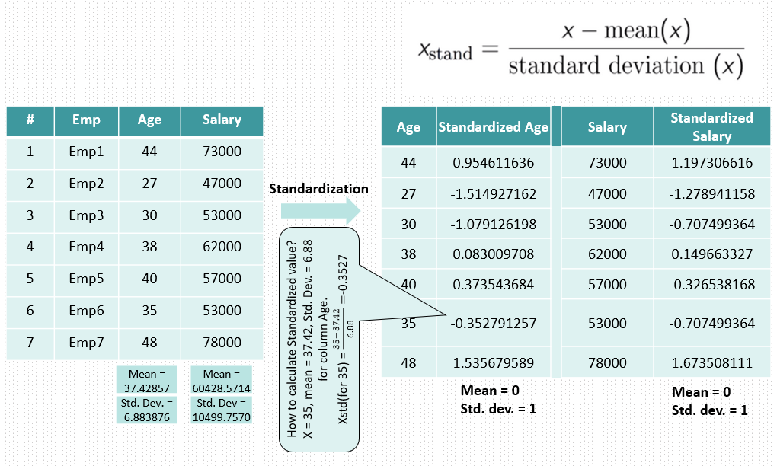
Standardization

Slide 7
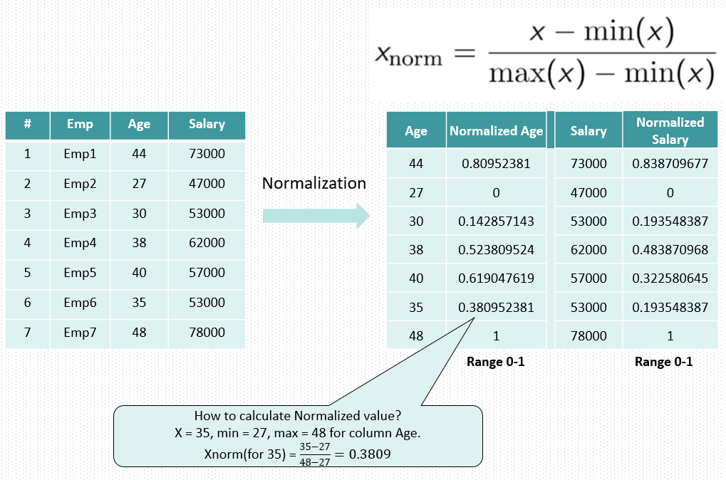
Normalization

Slide 8
Normalization | Standardization
This method scales the model using minimum and maximum values. | This method scales the model using the mean and standard deviation.
When features are on various scales, it is functional. | When a variable's mean and standard deviation are both set to 0, it is beneficial.
Values on the scale fall between [0, 1] and [-1, 1]. | Values on a scale are not constrained to a particular range.
Additionally known as scaling normalization. | This process is called Z-score normalization.
When the feature distribution is unclear, it is helpful. | When the feature distribution is consistent, it is helpful.
2. Normalization vs Standardization

Slide 9
Standardization, also known as Z-score scaling, is a data preprocessing technique that transforms your data to have a mean of 0 and a standard deviation of 1.
It is a popular method for making different features or variables comparable.
There are various scaling methods available for standardization, including:
Standard Scaler: This is one of the most common methods for standardization. It scales the data to have a mean of 0 and a standard deviation of 1. It subtracts the mean and divides by the standard deviation for each feature.
Robust Scaler: Robust scaling is less affected by outliers than Standard Scaler. It scales the data based on the median and interquartile range (IQR) instead of the mean and standard deviation. It is useful when your data contains outliers.
MinMax Scaler: Min-Max scaling, also known as normalization, scales the data to a specific range, typically between 0 and 1. It subtracts the minimum value and divides by the range (maximum - minimum).
Max abs scaler

Slide 10
https://scikit-learn.org/stable/install.html

Slide 11
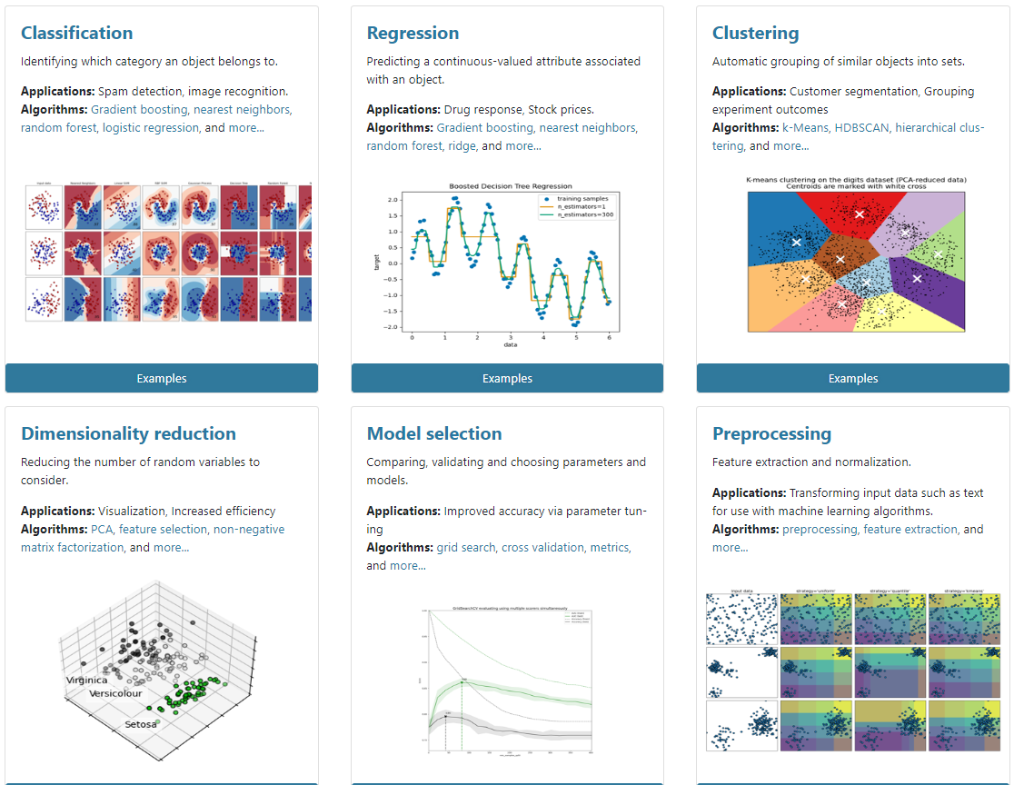


Slide 12
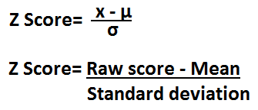
3. Standard Scaling approach:
Characteristic of scaled data, Merit and Demerit of this technique
Characteristics of Standard Scaling:
Transformation to Z-scores: Standard Scaling transforms the data in such a way that it has a mean (average) of 0 and a standard deviation of 1. This is done for each feature independently.
Centered Data: The scaled data is centered around zero, which means that the mean of the scaled data is zero. This makes it easier to compare features with different units and scales.
Preservation of Distribution Shape: Standard Scaling doesn't change the shape of the distribution of the original data. If the original data is approximately normally distributed, the scaled data will be as well.
Person A: Income = Rs 60,000, Age = 30 years
Person B: Income = Rs 30,000, Age = 50 years
Without scaling, these features have different scales and magnitudes.
After standard scaling, the data will be transformed as follows:
Person A (Standardized): Income = 1, Age = -1
Person B (Standardized): Income = -1, Age = 1
Now, the data is centered around 0 and has a standard deviation of 1 for both features, making them directly comparable and suitable for machine learning algorithms.

Slide 13

3. Standard Scaling approach:
Characteristic of scaled data, Merit and Demerit of this technique
Merits of Standard Scaling:
Mean and Variance Preservation: Standard Scaling preserves the mean and variance of the original data. This can be useful when working with algorithms that assume data is normally distributed or when you want to compare features on a common scale.
Robust to Outliers: Standard Scaling is less affected by outliers compared to Min-Max scaling. Outliers have less influence on the mean and standard deviation than they do on the range of values.
Interpretability: The scaled data is easy to interpret. A value of 0 means the data point is at the mean, positive values indicate data points above the mean, and negative values indicate data points below the mean.

Slide 14
3. Standard Scaling approach:
Characteristic of scaled data, Merit and Demerit of this technique
Demerits of Standard Scaling:
Loss of Information for Non-Normal Data: Standard Scaling assumes that your data is normally distributed. If your data is not normally distributed, the transformation may not be appropriate, and it could lead to a loss of information. Other scaling methods like Min-Max scaling may be more suitable in such cases.
Sensitive to Outliers: While Standard Scaling is less sensitive to outliers than Min-Max scaling, extreme outliers can still affect the mean and standard deviation, potentially leading to inaccurate scaling.
Not Suitable for Sparse Data: In the case of sparse datasets with many zero values, standardization can result in division by very small standard deviations, which may lead to numerical instability. In such cases, other scaling methods like Max-Abs scaling may be more appropriate.

Slide 15
4. Minmax Scaling approach:
Characteristic of scaled data, Merit and Demerit of this technique
Min-Max scaling, also known as normalization, is a data preprocessing technique that transforms your data to a specific range, typically between 0 and 1.
This approach scales your data to a specific minimum and maximum value, making it more suitable for machine learning algorithms that require all features to be on the same scale.
Characteristics of Min-Max Scaled Data:
Range: After Min-Max scaling, the data is rescaled to a specified range, typically between 0 and 1, although you can choose a different range if needed.
Linear Transformation: Min-Max scaling performs a linear transformation that preserves the relative distances between data points.
Uniform Scale: All features are scaled uniformly to the same range, which ensures that no feature dominates due to its original scale.

Slide 16
4. Minmax Scaling approach:
Characteristic of scaled data, Merit and Demerit of this technique
Merits of Min-Max Scaling:
Scale Invariance: Min-Max scaling makes the data scale-invariant, ensuring that the magnitude of the original values does not affect the results, similar to standard scaling.
Easy Interpretation: After Min-Max scaling, the data is interpretable because the scaled values still retain a clear relationship with the original data range. Values between 0 and 1 are easily understood.
Preserves Relationships: Min-Max scaling preserves relationships between data points, as it performs a linear transformation without changing the shape of the distribution.

Slide 17
4. Minmax Scaling approach:
Characteristic of scaled data, Merit and Demerit of this technique
Demerits of Min-Max Scaling:
Sensitivity to Outliers: Like standard scaling, Min-Max scaling can be sensitive to outliers. Outliers can significantly affect the range and may lead to issues in the scaled data.
Not Suitable for All Distributions: Min-Max scaling assumes that the data is distributed within a specified range. If your data is not distributed uniformly, or if it contains extreme outliers, Min-Max scaling may not be appropriate.

Slide 18
5. Normalizer Scaling approach:
Characteristic of scaled data, Merit and Demerit of this technique
The Normalizer scaling approach is a data preprocessing technique that scales individual data points (rows) rather than features (columns). It is used to scale the values within each row to a common scale, typically by rescaling them to have a magnitude of 1 (L2 norm) or to be within a specific range.
Characteristics of Normalized Data:
Row-wise Scaling: Normalizer scales data points (rows) individually, treating each row as an independent entity.
Magnitude-Based Scaling: The primary goal of normalization is to adjust the magnitude of each data point to a common scale. This is often achieved by ensuring that the L2 norm (Euclidean norm) of each row is 1.
Direction Preservation: While the magnitude of each row is adjusted, the direction (orientation) of each data point remains the same.

Slide 19
5. Normalizer Scaling approach:
Characteristic of scaled data, Merit and Demerit of this technique
Merits of Normalizer Scaling:
Scale Independence: Normalization is particularly useful when the scale of each data point varies significantly. It ensures that each data point has the same magnitude, making them directly comparable.
Useful for Distance Metrics: Normalization is often used with distance-based algorithms, such as K-nearest neighbors (K-NN), where the distance between data points is crucial. Normalized data allows distances to be calculated without being dominated by features with larger scales.
Directional Information Preservation: Normalization ensures that the directional information in the data is retained, which is beneficial in applications where the direction is essential, such as in text data analysis.

Slide 20
5. Normalizer Scaling approach:
Characteristic of scaled data, Merit and Demerit of this technique
Demerits of Normalizer Scaling:
Loss of Feature Information: Normalization does not consider the relationships between features.
It focuses solely on the magnitude of data points, which may not be suitable for all applications.
Lack of Feature Scaling: Normalization does not scale individual features.
If feature scaling is needed, additional preprocessing steps may be necessary.

Slide 21
6. Comparison between scaling and transformations
Scaling and transformations are both techniques used in data preprocessing to prepare data for machine learning models.
Aspect | Scaling | Transformations
Purpose | Adjust the scale of data (range or magnitude) | Change the distribution or shape of data
Common Techniques | Standard Scaling (Z-score scaling), Min-Max Scaling (Normalization), Robust Scaling | Log transformation, Power transformation, Feature engineering (e.g., one-hot encoding)
Effect on Data | Doesn't change the shape or distribution, but ensures consistent feature scale | Alters the shape and distribution of data
Normalization | Primarily for normalization, making features comparable | While some transformations may normalize data, the primary goal is to modify data distributions
Changes to Mean and Variance | In standard scaling, the mean becomes 0, and the standard deviation becomes 1. In Min-Max scaling, the range is typically between 0 and 1 | Transforms data without specific regard for mean and variance
Use Cases | Effective when making features comparable by removing the impact of their original scales, improving convergence and stability of certain machine learning algorithms | Useful when data is not normally distributed and needs to conform to a particular distribution or reduce skewness, as well as in feature engineering to create new features or represent categorical data

Slide 22


7. Feature Engineering : Deriving new feature
Feature engineering is a critical step in the data preprocessing phase of a machine learning project.
It involves creating new features (variables) from existing data to improve the performance of machine learning models.
Feature engineering can enhance model accuracy, reduce overfitting, and reveal valuable information that may not be apparent in the original dataset.

Slide 23
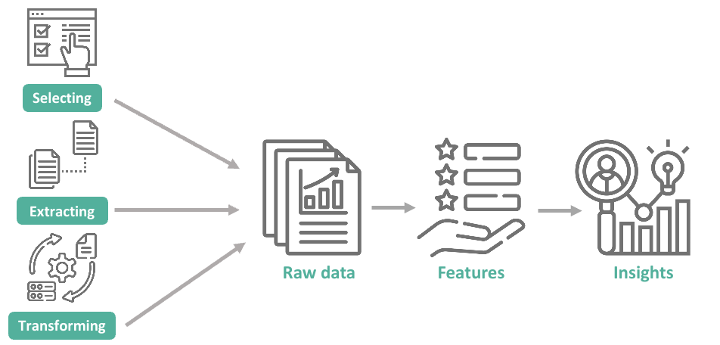
7. Feature Engineering : Deriving new feature
Feature engineering is a critical step in the data preprocessing phase of a machine learning project.
It involves creating new features (variables) from existing data to improve the performance of machine learning models.
Feature engineering can enhance model accuracy, reduce overfitting, and reveal valuable information that may not be apparent in the original dataset.

Slide 24
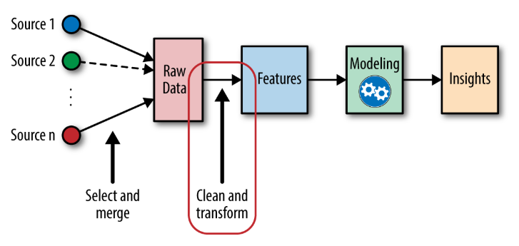
Feature engineering for machine learning-- 5 steps:
Understand the Data
Exploratory Data Analysis (EDA)
Handle Missing Data
Create New Features
Feature Scaling and Normalization
This is particularly important for algorithms that are sensitive to the scale of features, such as k-nearest neighbors or support vector machines.

Slide 25
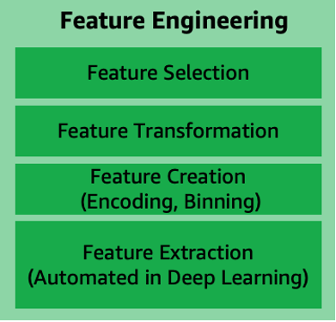
1. Feature Selection:
Definition: Feature selection is the process of choosing a subset of relevant features from the original set of features in a dataset.
Objective: Reduce the number of features while retaining the most informative and impactful ones.
Methods: Techniques like filter methods (e.g., correlation analysis), wrapper methods (e.g., recursive feature elimination), and embedded methods (e.g., regularization) are employed for feature selection.
2. Feature Transformation:
Definition: Feature transformation involves changing the representation of features in the dataset, often by applying mathematical functions or operations.
Objective: Alter the scale or distribution of features to meet the assumptions of certain algorithms or improve model performance.
Methods: Common techniques include logarithmic transformations, square root transformations, and Box-Cox transformations for numerical features.

Slide 26
3. Feature Creation:
Definition: Feature creation involves generating entirely new features from the existing ones, often by combining or manipulating them.
Objective: Introduce new information that might be more relevant or meaningful for the machine learning model.
Examples: Creating interaction terms, polynomial features, or aggregating information from multiple features.
4. Feature Extraction:
Definition: Feature extraction involves reducing the dimensionality of the dataset by transforming it into a lower-dimensional space.
Objective: Capture the essential information in the data while discarding redundant or less important features.
Methods: Techniques like Principal Component Analysis (PCA), t-Distributed Stochastic Neighbor Embedding (t-SNE), and autoencoders are used for feature extraction.

Slide 27
7. Feature Engineering : Deriving new feature
Binning or Discretization: This technique involves dividing a continuous feature into discrete bins or intervals. It can be useful for converting numerical features into categorical ones. For example, you can bin age data into categories like "child," "adult," and "senior.“
Encoding Categorical Variables: When dealing with categorical data, you can use techniques like one-hot encoding, label encoding, or target encoding to transform them into a format suitable for machine learning algorithms.
Example: RED-1, Blue-2, Orance-3
Feature Scaling: Standard scaling (Z-score scaling), Min-Max scaling, or other scaling techniques can be applied to numerical features to make them more suitable for machine learning algorithms. Scaling ensures that features have similar scales, which is important for distance-based algorithms. Perform scaling large values between 0 and 1
Polynomial Features: Creating polynomial features involves adding powers of existing features to capture nonlinear relationships. For example, adding squared or cubed terms of a variable can account for quadratic or cubic effects.

Slide 28
7. Feature Engineering : Deriving new feature
5. Feature Interactions: You can create new features by combining existing ones. For example, if you have features "length" and "width," you can create a new feature "area" by multiplying them.
6. Logarithmic or Exponential Transformations: Applying logarithmic or exponential transformations to a feature can help deal with skewed data distributions and make relationships more linear. Apply log and reduce the values
7. Time Features: When working with time series data, you can extract various time-related features, such as day of the week, month, season, or time since a specific event.
8. Aggregation and Grouping: Aggregate data by grouping it based on specific criteria. For example, you can calculate statistics (e.g., mean, sum, or count) for a group of records. Aggregations are useful for creating summary features.

Slide 29
7. Feature Engineering : Deriving new feature
9. Domain-Specific Features: In some cases, domain knowledge can lead to the creation of domain-specific features. For instance, in medical data, a computed feature like "body mass index (BMI)" can be useful.
10. Feature Extraction: Techniques like Principal Component Analysis (PCA) or Linear Discriminant Analysis (LDA) can be used to reduce the dimensionality of data while preserving important information in the form of new features.
Feature engineering often involves a combination of these techniques, and it requires a good understanding of the data and the problem you're trying to solve.
Experimentation and domain knowledge are crucial for creating informative and effective features.

Slide 30
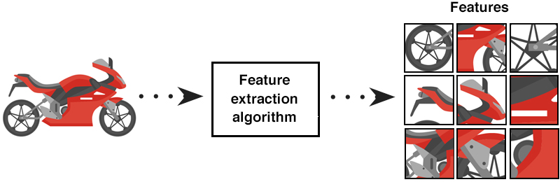
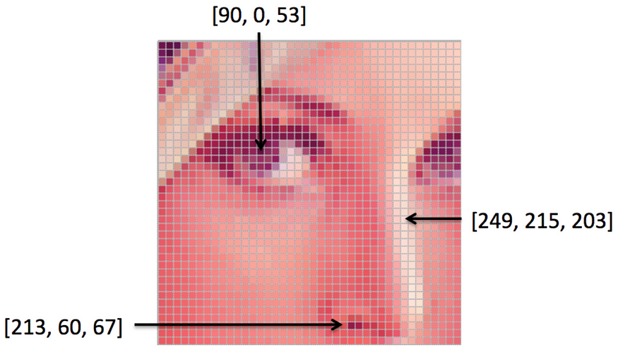
7. Feature Engineering : Deriving new feature (Computer vision)
Computer vision
1. Pixel values
Pixel values are the most basic features in an image.
Each pixel contains information about colour, intensity, and brightness. For grayscale images, each pixel is represented by a single value (power), while for coloured images, each pixel is represented by a combination of values (e.g., RGB values).
https://convertingcolors.com/rgb-color-213_60_67.html?search=RGB(213,60,67)

Slide 31
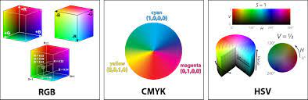
7. Feature Engineering : Deriving new feature (Computer vision)
2. Color spaces – Color model transform
Transforming the image from RGB to other colour spaces like HSV, LAB, or YUV can reveal important features that might be useful for certain tasks.

Slide 32
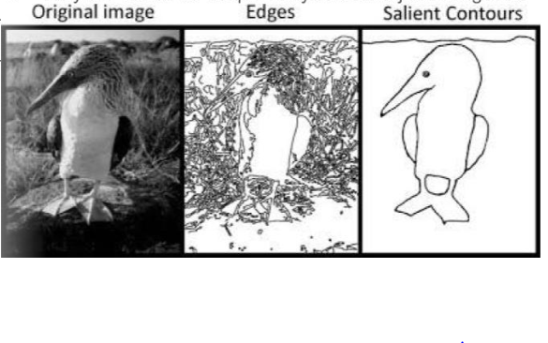
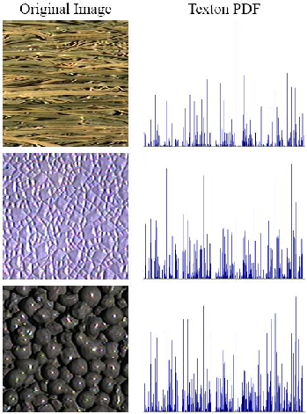
7. Feature Engineering : Deriving new feature (Computer vision)
3. Edges and Contours
Edge detection algorithms like the Canny edge detector can be used to identify edges and contours in images. Edges often contain important information about object boundaries.
4. Texture Analysis
Texture features capture patterns in different regions of the image.

Slide 33
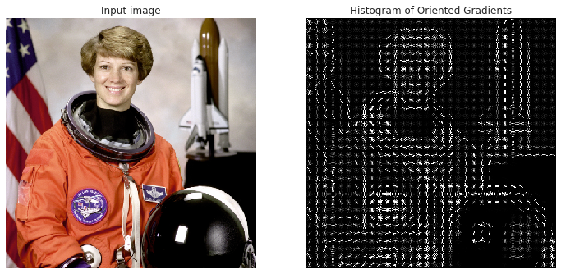
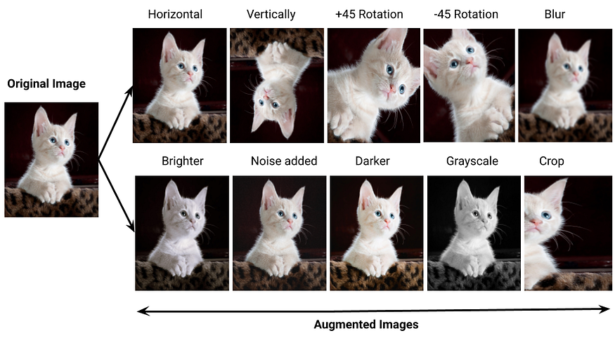
7. Feature Engineering : Deriving new feature (Computer vision)
5. HOG (Histogram of Oriented Gradients)
HOG is particularly effective in object detection.
It quantifies the distribution of gradient orientations in localized portions of the image and is robust against variations in lighting and shadows.
6. Data Augmentation
Data augmentation involves creating new training examples by applying various image transformations like rotation, flipping, scaling, and changes in brightness. This technique helps in generating additional diverse features and prevents overfitting.

Slide 34



7. Feature Engineering : Deriving new feature (Computer vision)
pip install opencv-python
pip install --upgrade pip
pip install scikit-image
https://pythonprogramming.net/loading-images-python-opencv-tutorial/
https://repository.niddk.nih.gov/home/ US Govt Website
https://data.world/data-society/pima-indians-diabetes-database
https://gis.cdc.gov/grasp/diabetes/diabetesatlas-analysis.html

Slide 35
8. Identifying the feature significance use univariate and bivariate/multivariate analysis
Identifying feature significance is a crucial step in the feature selection and data preprocessing process for machine learning. Univariate and bivariate/multivariate analyses are common techniques to assess the importance of features.
1. Univariate Analysis: Univariate analysis assesses the significance of individual features in isolation. Common univariate methods include statistical tests and feature ranking techniques.
Example: Suppose you have a dataset with various features, including 'Age,' 'Income,' and 'Education Level.' To determine the significance of each feature, you can perform univariate analysis using statistical tests such as:
ANOVA (Analysis of Variance): This test assesses whether there are statistically significant differences in the means of a numerical feature (e.g., 'Income') among different categories of a categorical feature (e.g., 'Education Level').
Here's a simple Python example using synthetic dat

Slide 36
8. Identifying the feature significance use univariate and bivariate/multivariate analysis
ANOVA (Analysis of Variance): This test assesses whether there are statistically significant differences in the means of a numerical feature (e.g., 'Income') among different categories of a categorical feature (e.g., 'Education Level').
Here's a simple Python example using synthetic data:
import pandas as pd
from scipy.stats import f_oneway
data = pd.DataFrame({'Education Level': ['High School', 'Bachelor', 'Master', 'High School', 'Bachelor'],
'Income': [40000, 60000, 80000, 35000, 65000]})
# Perform ANOVA to test the significance of 'Income' with respect to 'Education Level'
grouped_data = [data['Income'][data['Education Level'] == level] for level in data['Education Level']]
f_statistic, p_value = f_oneway(*grouped_data)
print(f'F-statistic: {f_statistic}, p-value: {p_value}')
In this example, we use the ANOVA test to assess the significance of 'Income' with respect to 'Education Level.'

Slide 37
8. Identifying the feature significance use univariate and bivariate/multivariate analysis
2. Bivariate/Multivariate Analysis: Bivariate and multivariate analyses consider relationships between features.
These methods help determine how features interact with each other and assess their combined importance.
Example: Consider a dataset with 'Age,' 'Income,' and 'Education Level.' To analyze feature significance using a multivariate approach, you can use a correlation matrix to explore relationships between numeric features.
For example, you can check the correlation between 'Age' and 'Income.'
import pandas as pd
data = pd.DataFrame({'Age': [25, 30, 35, 40, 45],
'Income': [50000, 60000, 75000, 80000, 90000]})
# Calculate the correlation matrix
correlation_matrix = data.corr()
# Check the correlation between 'Age' and 'Income'
age_income_correlation = correlation_matrix.loc['Age', 'Income']
print(f'Correlation between Age and Income: {age_income_correlation}')
In this example, you calculate the correlation between 'Age' and 'Income' to assess their relationship and significance.

Slide 38

https://www.linkedin.com/in/gopirajan/
Thank you

